Slide 1
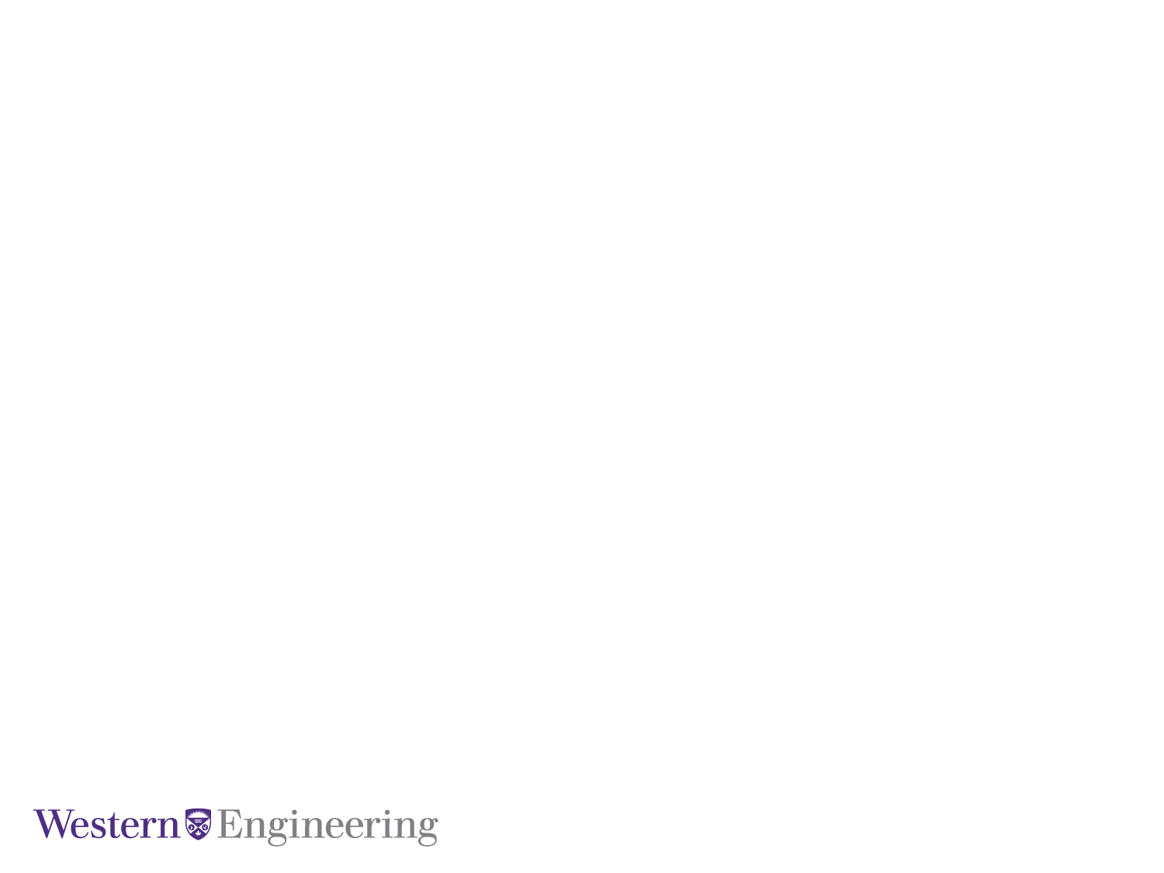
Feature Encoding Strategies for Multi-View Image Classification
M.E.Sc Candidate: Kyle Doerr
Supervisor: Dr. Samarabandu
Co-Supervisor: Dr. Wang
January 26, 2016
Electrical and Computer Engineering

Slide 2
Outline
Motivation
Contributions
Background on image classification
Feature Encoding techniques
Triangulation Embedding
Results
Conclusion
Future Work
Notes:
find better names or something

Slide 3
Motivation
Recent advances in computer vision
Limited active research on machine vision problems
Many manufacturing industries still rely on human inspection
Notes:
-Past several years there has been considerable advances in CV with respect to image classificaiton & retreival
-Limited work applying CV to MV
- …. ....
-Many <industry, factory? > rely solely on humans for tasks such as identification and defect detection which is error prone
- ….. ... . ..
Recent advances in computer vision
particularly with classification & retrieval tasks
Limited active research on machine vision problems
Many manufacturing industries still rely on human inspection

Slide 4
Contributions
A machine vision framework that can classify very similar automotive parts:
High classification accuracy to be useful in manufacturing environments
Near real-time classification
An evaluation feature encoding techniques:
With multiple view data
Results that generalize from machine vision to computer vision problems
Notes:
-A machine vision framework that can classify very similar automative parts in
- Can classify near real time
- High classification accuracy to be useful in manufacturing environments
-An indepth comparison of binary features (ORB) to traditional SIFT and SURF image features
- …
-A demonstration on advanced feature encoding techniques for fine-grained image classification that generalizes to MENTION CALTECH
-An object classification framework using binary features that can classify very similar automative parts in near real-time
-A cost effective machine vision system that is robust enough for industrial applications:
-Used inexpensive webcams
-Robust enough that <high class acc> in event of damaged camera

Slide 5
Contributions
A new object classification framework using binary ORB features that can classify very similar automotive parts real-time and provide a meaningful, robust solution for manufacturing settings.
A multi view vision system that can handle a missing input
Notes:
-A machine vision framework that can classify very similar automative parts in
- Can classify near real time
- High classification accuracy to be useful in manufacturing environments
-An indepth comparison of binary features (ORB) to traditional SIFT and SURF image features
- …
-A demonstration on advanced feature encoding techniques for fine-grained image classification that generalizes to MENTION CALTECH
-An object classification framework using binary features that can classify very similar automative parts in near real-time
-A cost effective machine vision system that is robust enough for industrial applications:
-Used inexpensive webcams
-Robust enough that <high class acc> in event of damaged camera

Slide 6
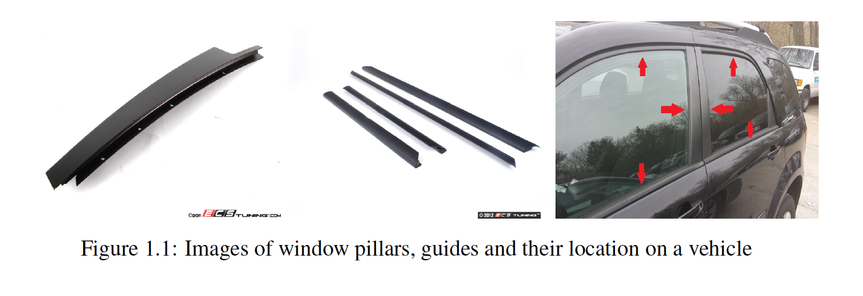
Introduction to the Problem
The problem focuses on the correct classification of window pillars and guides
Notes:
-The problem focuses on correct classification of window pillars and guides (see fig1.1)
-These types of autoparts have minimal variations in size, orientation, texture and luster … yet the parts must be correctly labelled during the vehicle assembly or for replacement parts
-A typical automotive plant can manufacturer several thousand of these parts a day
-Previously, correct labelling of these parts was left to humans.
->Difficult to identify small similarities on a moving belt
->Human fatigue during an 8+ hour shift
->More than one vehicle make and several models
High rate of human error
->the plant has to absorb the associated costs of shipping incorrectly labelled part
->lack of qualitiy control leads to unsatisfied customers
->
- The plant employs humans to solely watch andwere assigned to identify the parts
-
-Correct classification of automotive parts
-Many automotive parts

Slide 7
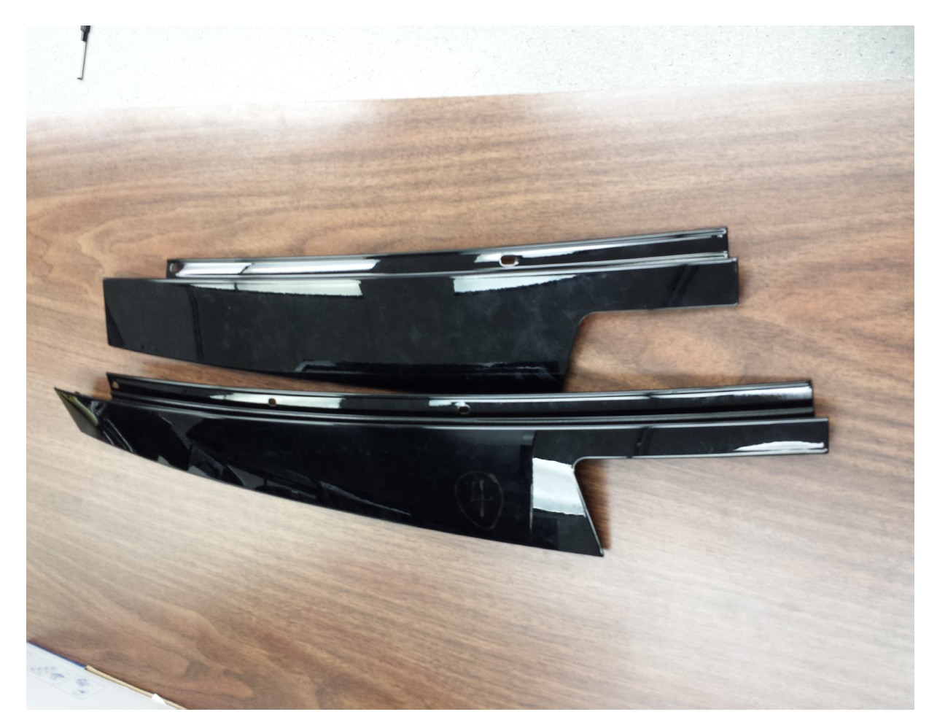
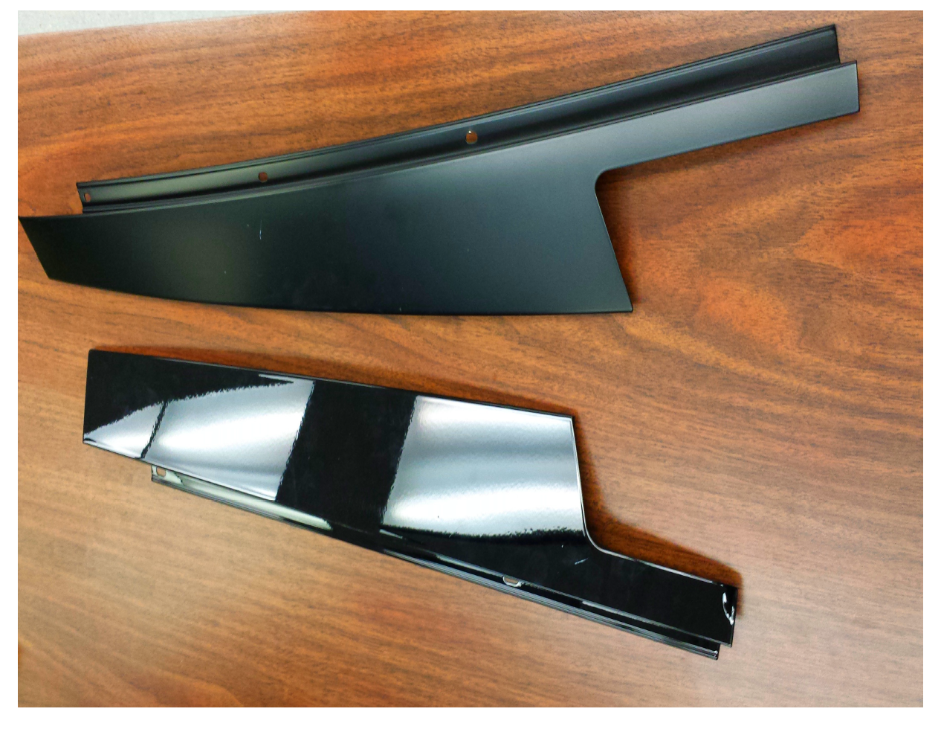
Introduction to the Problem
Variations in length, orientation and luster
Notes:
-The problem focuses on correct classification of window pillars and guides (see fig1.1)
-These types of autoparts have minimal variations in size, orientation, texture and luster … yet the parts must be correctly labelled during the vehicle assembly or for replacement parts
-A typical automotive plant can manufacturer several thousand of these parts a day
-Previously, correct labelling of these parts was left to humans.
->Difficult to identify small similarities on a moving belt
->Human fatigue during an 8+ hour shift
->More than one vehicle make and several models
High rate of human error
->the plant has to absorb the associated costs of shipping incorrectly labelled part
->lack of qualitiy control leads to unsatisfied customers
->
- The plant employs humans to solely watch andwere assigned to identify the parts
-
-Correct classification of automotive parts
-Many automotive parts

Slide 8
Introduction to the Problem
A typical automotive plant can manufacturer several thousand of these parts a day
Previously, correct labelling of these parts was left to humans:
Difficult to identify small similarities on a moving belt
Human fatigue during an 8+ hour shift
More than one vehicle make with several models
Presentation Title Here
Notes:
-The problem focuses on correct classification of window pillars and guides (see fig1.1)
-These types of autoparts have minimal variations in size, orientation, texture and luster … yet the parts must be correctly labelled during the vehicle assembly or for replacement parts
-A typical automotive plant can manufacturer several thousand of these parts a day
-Previously, correct labelling of these parts was left to humans.
->Difficult to identify small similarities on a moving belt
->Human fatigue during an 8+ hour shift
->More than one vehicle make and several models
High rate of human error
->the plant has to absorb the associated costs of shipping incorrectly labelled part
->lack of qualitiy control leads to unsatisfied customers
->
- The plant employs humans to solely watch andwere assigned to identify the parts
-
-Correct classification of automotive parts
-Many automotive parts

Slide 9
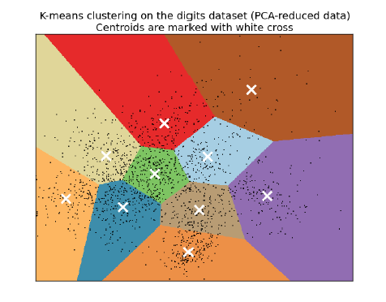
Background: Bag of Words
On an offline dataset perform feature extraction on the images
Run the unsupervised K-means clustering algorithm to construct the Visual Vocabulary
The centroids form the visual words

Slide 10
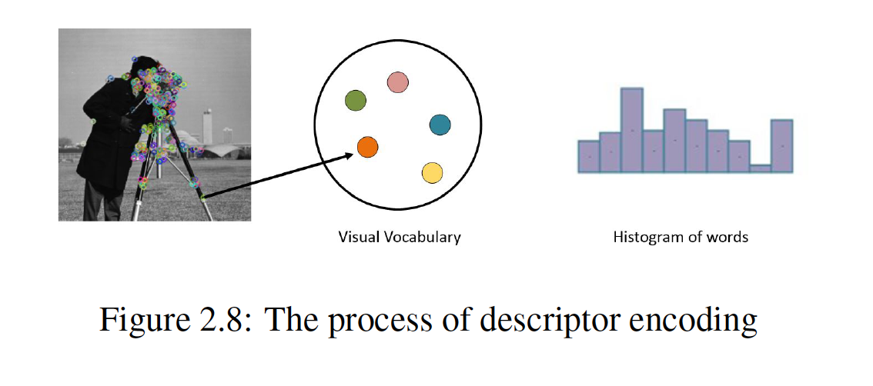
Background: Bag of Words
The formulation of the visual vocabulary now allows for building a training set
Features are matched to centroids by Nearest-Neighbour assignment

Slide 11
Vector of Locally Aggregated Descriptors
Extension to the Bag of words model
No longer encodes features as just a histogram of word counts
Contains ‘first order information’
Word assignment + distances to centroid
Presentation Title Here

Slide 12
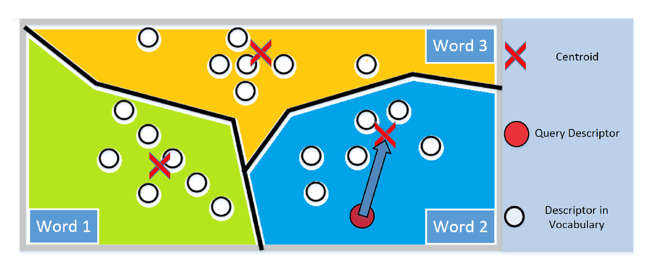
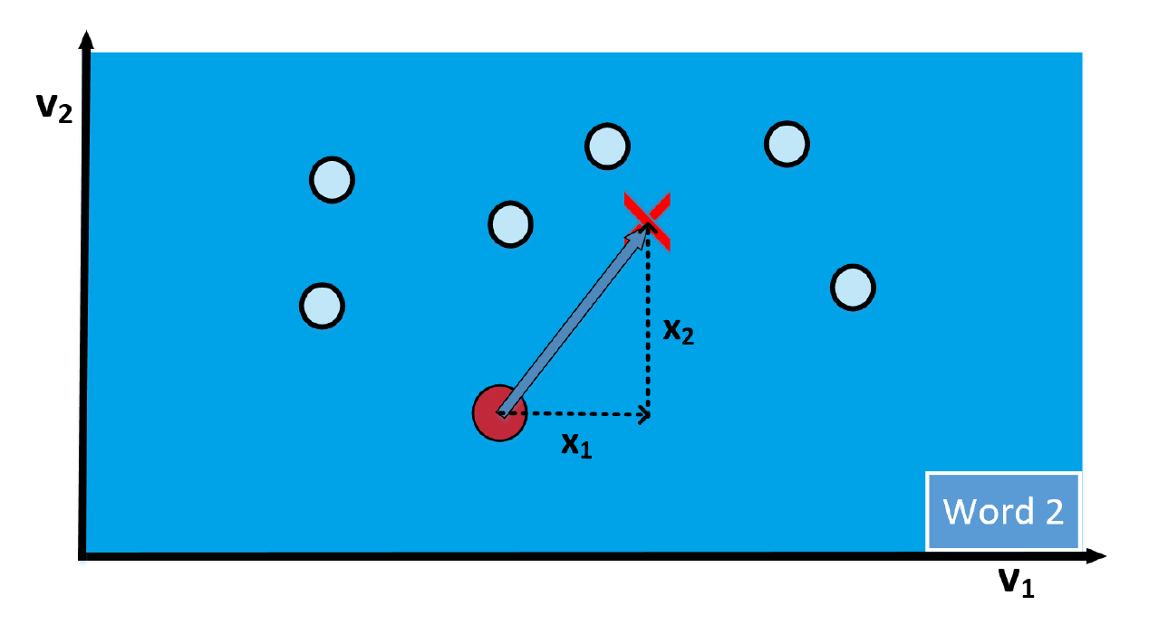
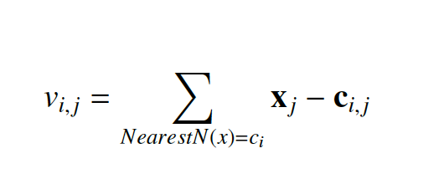
Vector of Locally Aggregated Descriptors
Presentation Title Here

Slide 13
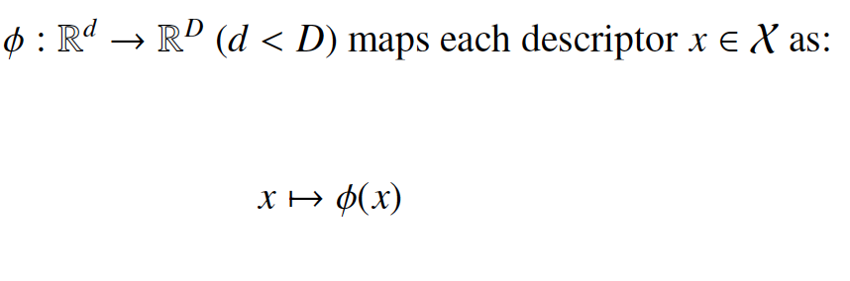
Triangulation Embedding
Extension of the VLAD representation but uses directional information over absolute distances
Two main steps: 1-Embedding and 2-Aggregation
Embedding:
Presentation Title Here

Slide 14
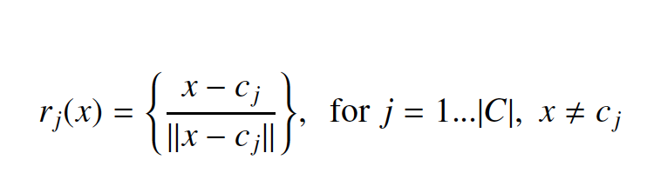
Triangulation Embedding
Embedding:
Define an embedding function
On the set of normalized residual descriptors:
Forming the set R(x)
Presentation Title Here

Slide 15
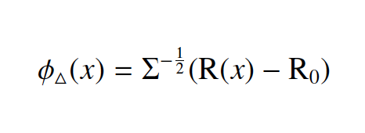
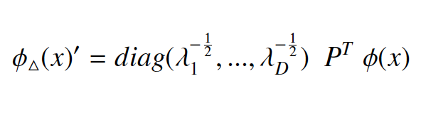
Triangulation Embedding
The set of residuals then undergo a whitening process: center, scale and rotate
R₀ = E_{X}[R(x)] and Σ – covariance matrix both learned on a training set
Presentation Title Here

Slide 16
Triangulation Embedding
Aggregation:
Presentation Title Here

Slide 17
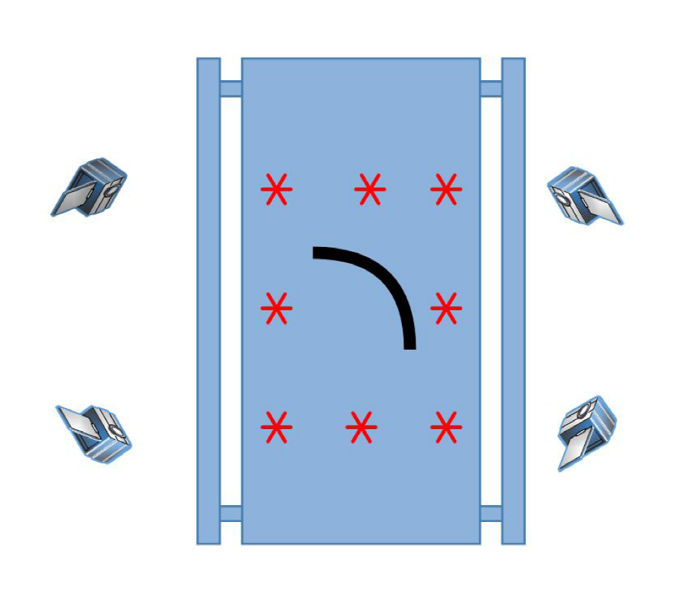
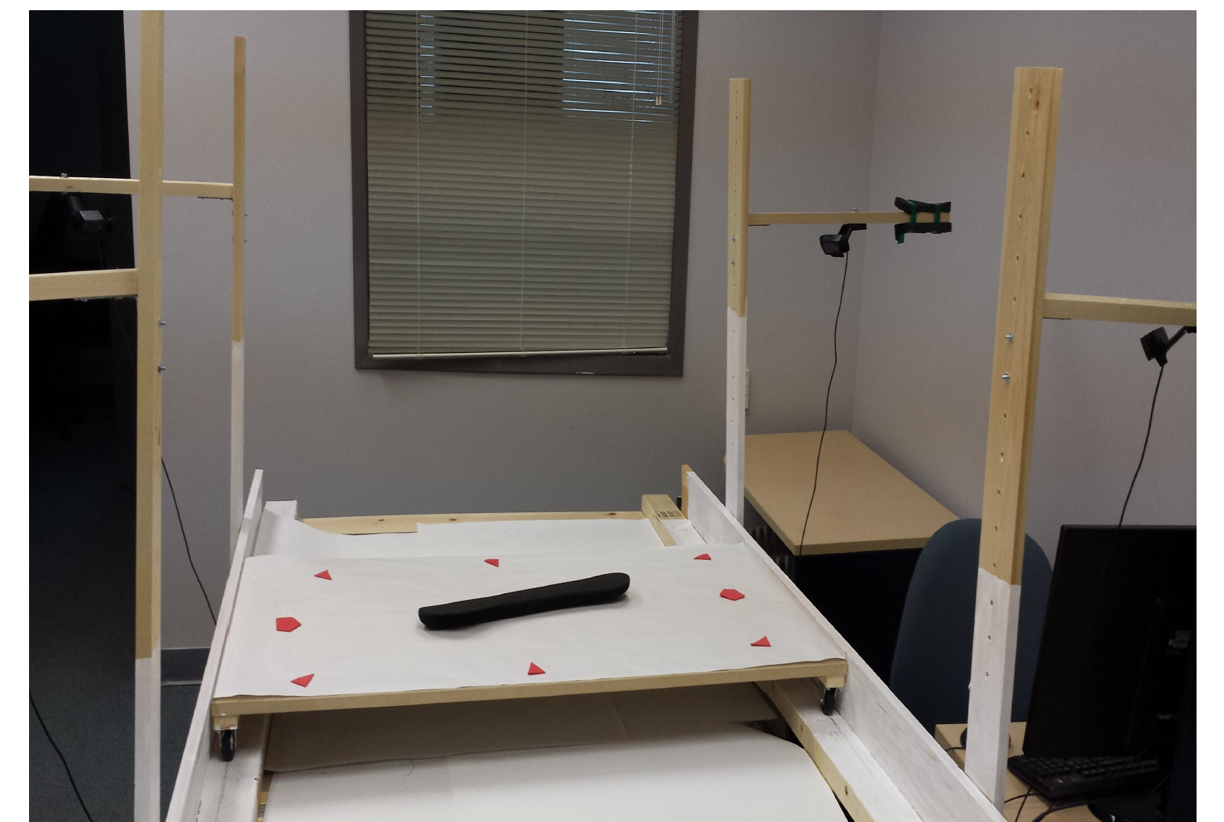
Proposed System
Presentation Title Here

Slide 18
Datasets
Qui vel estrum faccaep udiorit atieatio et, veris consect ionesecest.
Qui vel estrum faccaep udiorit atieatio et, veris consect ionesecest.
Qui vel estrum faccaep udiorit atieatio et, veris consect ionesecest.
Presentation Title Here

Slide 19
Problem 4.1 –
How does the selection of feature types affect classification performance?
ORB, SIFT, SURF
How to incorporate multiple view information to perform a single image classification?
Presentation Title Here

Slide 20
Problem 4.1 –
ORB Features:
HAVE MENTION ABOUT ORB
Presentation Title Here

Slide 21
Problem 4.1 –
Multiple view by aggregation
INSERT FORMULA
Presentation Title Here

Slide 22
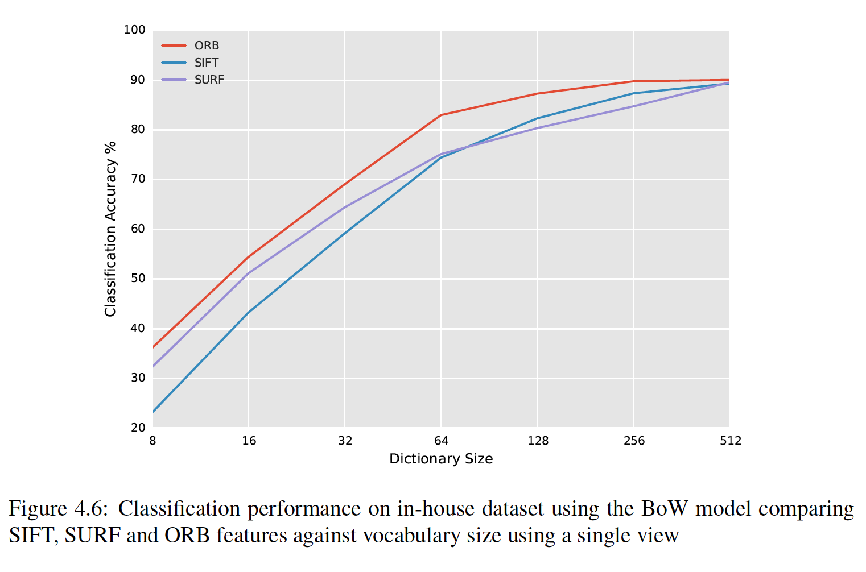
Results: Single View (in-house)
Presentation Title Here

Slide 23
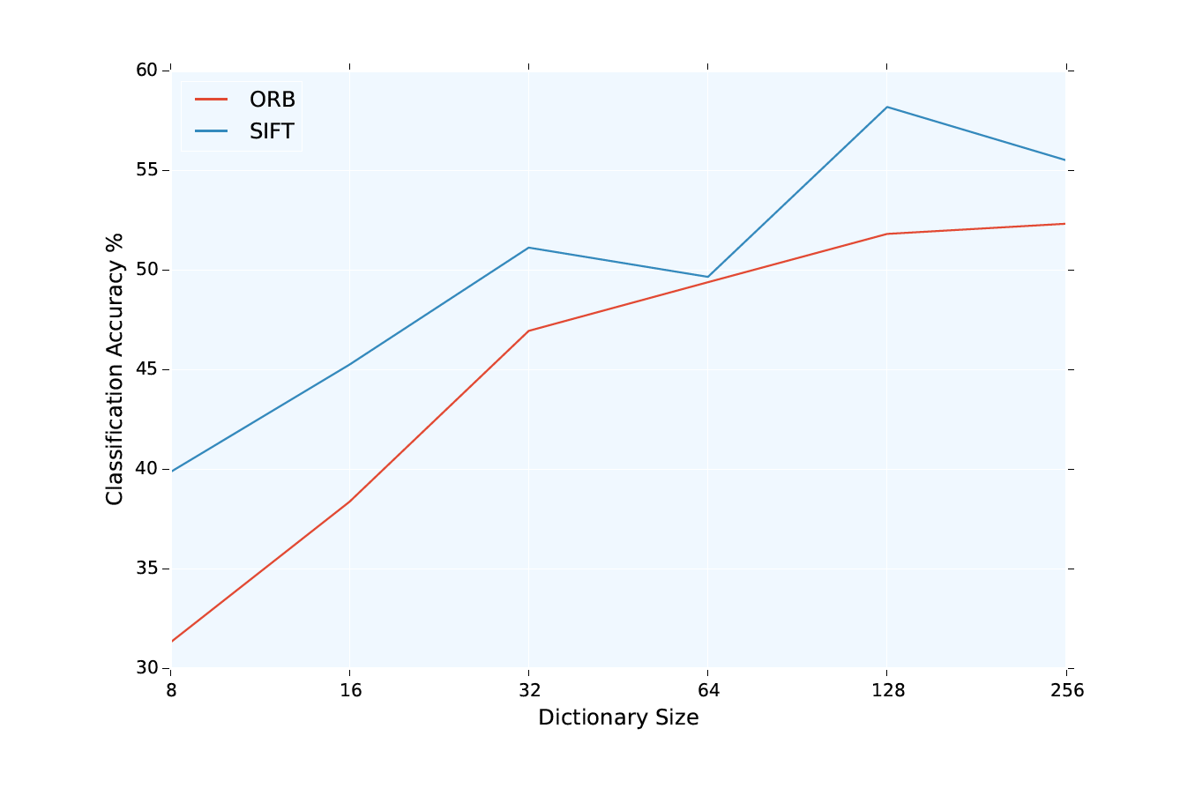
Results: Single View (CalTech)
Presentation Title Here

Slide 24
Analysis 4.1 –
ORB showed superior classification performance for in-house dataset but not CalTech:
CalTech dataset had much larger changes in scale and viewing angle
ORB appears to be more suitable in controlled environments
Accuracy as a function of dictionary size:
Diminishing returns
Trade off of increased classification time
ORB showed a classification speed increase of ~6.5x SIFT and ~3.4x SURF
Avoidance of license restrictions – both SIFT & SURF are patent protected
Presentation Title Here

Slide 25
P4.2 – single vs multiple
Car parts ~90% classification accuracy
Not acceptable if thousands of parts are processed per day
Discriminating features are occluded
Discriminative physical features may not be visible in the one view
Multi view representation is challenging:
Depth information / 3D reconstruction
Computationally expensive
Many techniques require camera calibration
Feature correspondence is challenging for this particular dataset
Presentation Title Here

Slide 26
P4.2 – single vs multiple
Proposed simple approach of concatenation of feature vectors over multiple views
Construct a feature vector for each view independently then concatenate
For i =1 to n views:
Fvec := fvec_{i}
Presentation Title Here

Slide 27
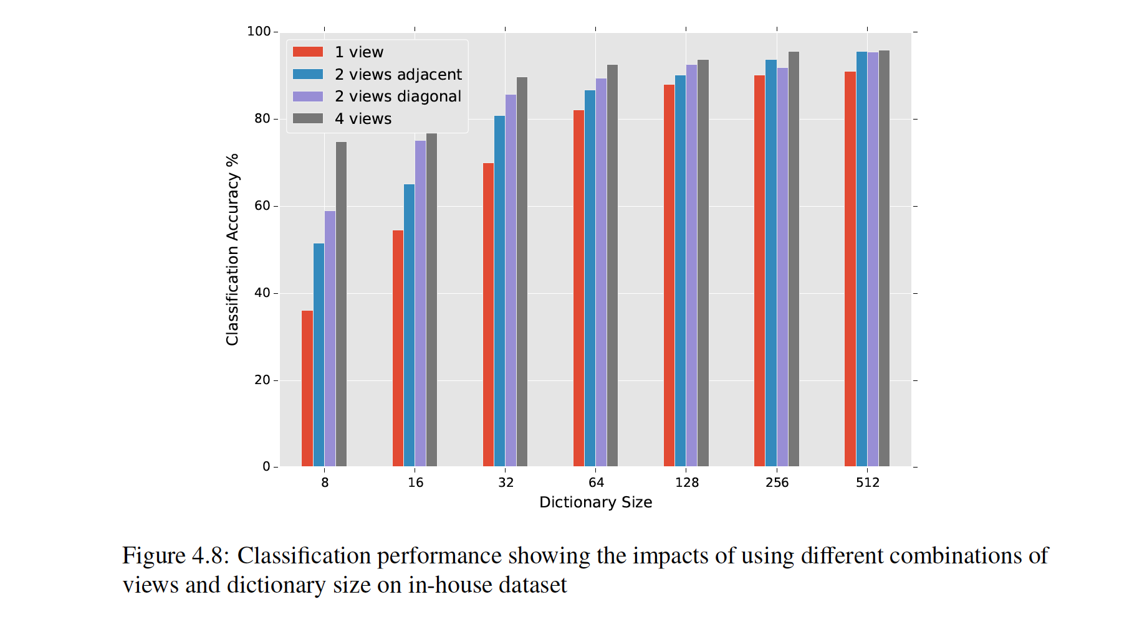
Results1 – 4.2
Presentation Title Here

Slide 28
Results1 – 4.2
Presentation Title Here

Slide 29
Significance1 4.2
Improve
Presentation Title Here

Slide 30
Results1 – 4.3
Qui vel estrum faccaep udiorit atieatio et, veris consect ionesecest.
Qui vel estrum faccaep udiorit atieatio et, veris consect ionesecest.
Qui vel estrum faccaep udiorit atieatio et, veris consect ionesecest.
Presentation Title Here

Slide 31
Significance1 4.3
Qui vel estrum faccaep udiorit atieatio et, veris consect ionesecest.
Qui vel estrum faccaep udiorit atieatio et, veris consect ionesecest.
Qui vel estrum faccaep udiorit atieatio et, veris consect ionesecest.
Presentation Title Here

Slide 32
Significance1 4.3
Qui vel estrum faccaep udiorit atieatio et, veris consect ionesecest.
Qui vel estrum faccaep udiorit atieatio et, veris consect ionesecest.
Qui vel estrum faccaep udiorit atieatio et, veris consect ionesecest.
Presentation Title Here

Slide 33
R2
Qui vel estrum faccaep udiorit atieatio et, veris consect ionesecest.
Qui vel estrum faccaep udiorit atieatio et, veris consect ionesecest.
Qui vel estrum faccaep udiorit atieatio et, veris consect ionesecest.
Presentation Title Here

Slide 34
S2
Qui vel estrum faccaep udiorit atieatio et, veris consect ionesecest.
Qui vel estrum faccaep udiorit atieatio et, veris consect ionesecest.
Qui vel estrum faccaep udiorit atieatio et, veris consect ionesecest.
Presentation Title Here

Slide 35
R3
Qui vel estrum faccaep udiorit atieatio et, veris consect ionesecest.
Qui vel estrum faccaep udiorit atieatio et, veris consect ionesecest.
Qui vel estrum faccaep udiorit atieatio et, veris consect ionesecest.
Presentation Title Here

Slide 36
S3
Qui vel estrum faccaep udiorit atieatio et, veris consect ionesecest.
Qui vel estrum faccaep udiorit atieatio et, veris consect ionesecest.
Qui vel estrum faccaep udiorit atieatio et, veris consect ionesecest.
Presentation Title Here

Slide 37
R4
Qui vel estrum faccaep udiorit atieatio et, veris consect ionesecest.
Qui vel estrum faccaep udiorit atieatio et, veris consect ionesecest.
Qui vel estrum faccaep udiorit atieatio et, veris consect ionesecest.
Presentation Title Here

Slide 38
S4
Qui vel estrum faccaep udiorit atieatio et, veris consect ionesecest.
Qui vel estrum faccaep udiorit atieatio et, veris consect ionesecest.
Qui vel estrum faccaep udiorit atieatio et, veris consect ionesecest.
Presentation Title Here

Slide 39
Conclusions
Qui vel estrum faccaep udiorit atieatio et, veris consect ionesecest.
Qui vel estrum faccaep udiorit atieatio et, veris consect ionesecest.
Qui vel estrum faccaep udiorit atieatio et, veris consect ionesecest.
Presentation Title Here

Slide 40
Future Works
Qui vel estrum faccaep udiorit atieatio et, veris consect ionesecest.
Qui vel estrum faccaep udiorit atieatio et, veris consect ionesecest.
Qui vel estrum faccaep udiorit atieatio et, veris consect ionesecest.
Presentation Title Here

Slide 41
ADD THANK YOU SLIDE
AND
ADD Q&A SLIDE
Qui vel estrum faccaep udiorit atieatio et, veris consect ionesecest.
Qui vel estrum faccaep udiorit atieatio et, veris consect ionesecest.
Qui vel estrum faccaep udiorit atieatio et, veris consect ionesecest.
Presentation Title Here

Slide 42
Title Here
Qui vel estrum faccaep udiorit atieatio et, veris consect ionesecest.
Qui vel estrum faccaep udiorit atieatio et, veris consect ionesecest.
Qui vel estrum faccaep udiorit atieatio et, veris consect ionesecest.
Presentation Title Here

Slide 43
Title Here
Qui vel estrum faccaep udiorit atieatio et, veris consect ionesecest.
Qui vel estrum faccaep udiorit atieatio et, veris consect ionesecest.
Qui vel estrum faccaep udiorit atieatio et, veris consect ionesecest.
Presentation Title Here

Slide 44
Title Here
Qui vel estrum faccaep udiorit atieatio et, veris consect ionesecest.
Qui vel estrum faccaep udiorit atieatio et, veris consect ionesecest.
Qui vel estrum faccaep udiorit atieatio et, veris consect ionesecest.
Presentation Title Here

Slide 45
Title Here
Qui vel estrum faccaep udiorit atieatio et, veris consect ionesecest.
Qui vel estrum faccaep udiorit atieatio et, veris consect ionesecest.
Qui vel estrum faccaep udiorit atieatio et, veris consect ionesecest.
Presentation Title Here

Slide 46
Title Here
Qui vel estrum faccaep udiorit atieatio et, veris consect ionesecest.
Qui vel estrum faccaep udiorit atieatio et, veris consect ionesecest.
Qui vel estrum faccaep udiorit atieatio et, veris consect ionesecest.
Presentation Title Here

Slide 47
Title Here
Qui vel estrum faccaep udiorit atieatio et, veris consect ionesecest.
Qui vel estrum faccaep udiorit atieatio et, veris consect ionesecest.
Qui vel estrum faccaep udiorit atieatio et, veris consect ionesecest.
Presentation Title Here

Slide 48
Title Here
Qui vel estrum faccaep udiorit atieatio et, veris consect ionesecest.
Qui vel estrum faccaep udiorit atieatio et, veris consect ionesecest.
Qui vel estrum faccaep udiorit atieatio et, veris consect ionesecest.
Presentation Title Here

Slide 49
Title Here
Qui vel estrum faccaep udiorit atieatio et, veris consect ionesecest.
Qui vel estrum faccaep udiorit atieatio et, veris consect ionesecest.
Qui vel estrum faccaep udiorit atieatio et, veris consect ionesecest.
Presentation Title Here

Slide 50
Title Here
Qui vel estrum faccaep udiorit atieatio et, veris consect ionesecest.
Qui vel estrum faccaep udiorit atieatio et, veris consect ionesecest.
Qui vel estrum faccaep udiorit atieatio et, veris consect ionesecest.
Presentation Title Here

Slide 51
Title Here
Qui vel estrum faccaep udiorit atieatio et, veris consect ionesecest.
Qui vel estrum faccaep udiorit atieatio et, veris consect ionesecest.
Qui vel estrum faccaep udiorit atieatio et, veris consect ionesecest.
Presentation Title Here

Slide 52
Title Here
Qui vel estrum faccaep udiorit atieatio et, veris consect ionesecest.
Qui vel estrum faccaep udiorit atieatio et, veris consect ionesecest.
Qui vel estrum faccaep udiorit atieatio et, veris consect ionesecest.
Presentation Title Here

Slide 53
Title Here
Qui vel estrum faccaep udiorit atieatio et, veris consect ionesecest.
Qui vel estrum faccaep udiorit atieatio et, veris consect ionesecest.
Qui vel estrum faccaep udiorit atieatio et, veris consect ionesecest.
Presentation Title Here

Slide 55

New Topic
Theme Area
Presentation Title Here

Slide 56
Title Here
Qui vel estrum faccaep udiorit atieatio et, veris consect ionesecest.
Qui vel estrum faccaep udiorit atieatio et, veris consect ionesecest.
Qui vel estrum faccaep udiorit atieatio et, veris consect ionesecest.
Presentation Title Here

Slide 57
Title Here
Presentation Title Here

Slide 58
Title Here
Presentation Title Here

Slide 59
Qui vel estrum faccaep udiorit atieatio et, veris consect ionesecest.
Qui vel estrum faccaep udiorit atieatio et, veris consect ionesecest.
Qui vel estrum faccaep udiorit atieatio et, veris consect ionesecest.
Presentation Title Here

Slide 60
Title Here
Qui vel estrum faccaep udiorit atieatio et, veris consect ionesecest.
Qui vel estrum faccaep udiorit atieatio et, veris consect ionesecest.
Qui vel estrum faccaep udiorit atieatio et, veris consect ionesecest.
Presentation Title Here

Slide 61


